Slide 1

Smart
Bedroom
Designed by:
Fabio Zippo

Slide 2


Introduction
The project implements a smart bedroom to enhance the experience of the owner of the house.
The smart controller of this bedroom allows the owner to:
Turn on/off the lights and adjust its brightness
Turn on/off the heating/cooling system and adjust its temperature
Turn on/off music, adjust the volume and scroll through songs
Finally, it allows the user to shut down or turn on all of these components simultaneously

Slide 3
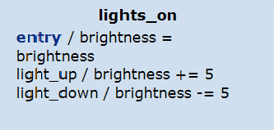
Requirements
R1: The user can turn on the lights and shut them down by the controller
R2: The user can adjust the brightness of the lights with a simple controller
R3 : The user can turn on the heating/cooling system and shut it down manually
R4: The user can adjust the temperature adding or subtracting one
R5: The user can turn on the music or shut it down manually
R6: The user can adjust the volume
R7: The user can scroll through songs or let them finish and go to next/previous
R8: The user can shut the whole system down with one command
R9: The user can turn the whole system on with one command

Slide 4
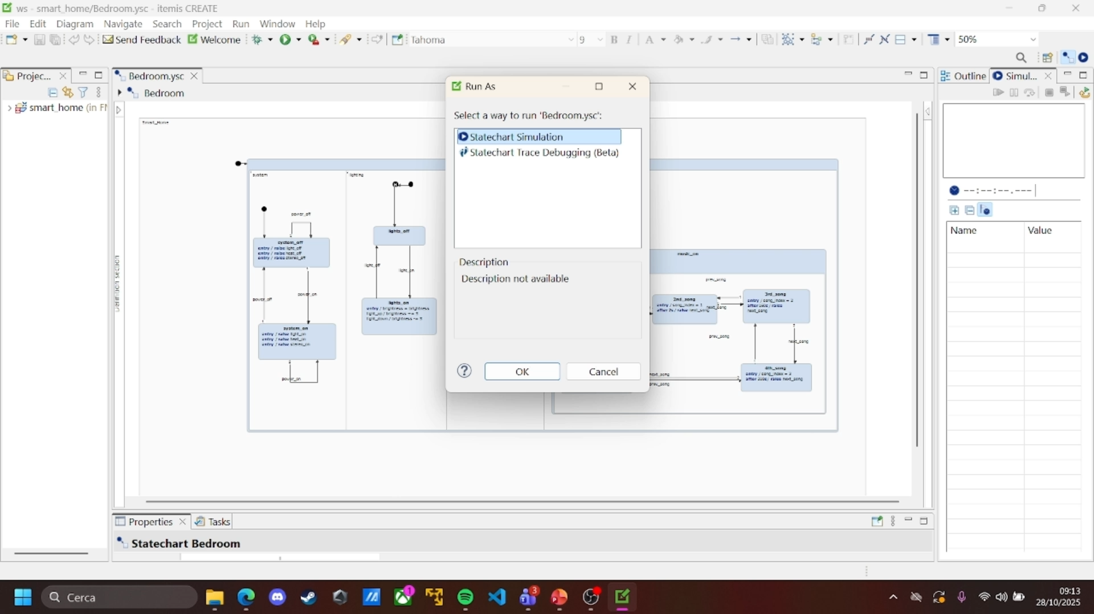
Simulation:

Slide 5
Thank You!

